Slide 1


SIGNATURE IDENTIFICATION
COMPUTER VISION
Presented by: Aditya Sanjay Thite(M22AI1001), Dr. Amit Kr. Pandey(M22AI1002), Rohan Kumar(M22AI1009)

Slide 2
ABSTRACT OF THE PROJECT
Signature is a crucial tool for individual identification, particularly in banking where withdrawal of money depends on it.
Signature verification is a common biometric technique used for personal identification.
In commercial scenarios like check payments, signature verification relies on human examination of known samples.
Imperfect systems in banks for checking signature authenticity can lead to fraud.
Instances of fraud signatures in banks are on the rise.
The project aims to identify real or fake signatures, implementing offline verification using geometric measures.
.

Slide 3



ABSTRACT
INTRODUCTION OF THE PROJECT
Objective: Develop an offline signature verification system to distinguish original from fake signatures.
Training: System trains on an authorized signature database to create a reference signature.
Verification Parameters: Uses parameters like Euclidean Distance to compare claimed and examined signatures.
Forgery Detection: Identifies a signature as fake if the parameter difference exceeds a set threshold.
.
.

Slide 4

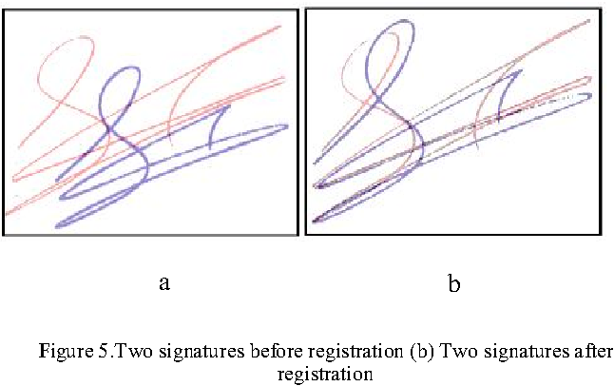

Discription of the Images
XXX denotes the ID of the person who has signed the document (e.g., 001).
ZZZ denotes the ID of the person to whom the signature belongs in reality (e.g., 001).
YYY denotes the nth number of attempts.
According to our criteria, if XXX is equal to ZZZ, then the image is considered genuine. Otherwise, if XXX is not equal to ZZZ, then the signature is considered forged or fake.

Slide 5

Literature survey
Researchers have used many technologies, such
as neural networks and they have done parallel
processing to signature verification and they are
introducing concepts, new ideas, algorithms day
by day.
Neural networks
Feature extraction
Measurements were taken on the traced signature, specifically focusing on the positions of feature points along its skeleton.
Image processing
Pattern recognition
There are many other approaches which is
evaluated of random forgeries like histograms
2D transforms.
Static verification
The findings suggest that the dynamics of these features are not stable for signature verification, as the emphasis is on shaping rather than temporal patterns. Note that our verification process exclusively deals with static images of signatures.

Slide 6

METHODOLOGY
01
User Input: User provides their User ID.
02
ID Verification: System checks if the ID is registered; if not, user submits five training signatures.
User Input
03
Testing Phase: Registered users are prompted to provide a signature for testing.
ID Verification
04
Testing Phase
Pre-processing: Both training and test signatures undergo pre-processing.
Reference and Sample Signatures: Training signatures become reference; test signature is saved for comparison.
Verification Stage
05
06
Verification Stage: System compares test signature with reference; if difference is within threshold, it's accepted; otherwise, rejected.

Slide 7



RESULT AND DISCUSSION
Identification of Original and Fake Signatures:
The project aims to distinguish between original and fake signatures through an offline signature verification system.
Training Phase
Training effectiveness depends on data size, quantity, and type. Our test set size is relatively smaller compared to general machine learning datasets, impacting training dynamics.
Human Action Variability
Signatures, being human-generated, are prone to variations and mistakes, even from the same individual.
Test Phase Challenges
Mistakes during testing may lead to isolated verification failures.
Training Phase Impact
Mistakes made during the training phase can have a cumulative effect, leading to a decrease in overall verification accuracy.

Slide 8

Conclusion
In the realm of signature verification, the successful implementation of our offline system marks a significant stride towards enhancing authentication processes. Our system, leveraging geometric measures and machine learning algorithms, has demonstrated commendable accuracy and robustness in verifying static signature images.
Drawing inspiration from the research paper on Automatic Signature Stability Analysis and Verification Using Local Features, we acknowledge the importance of considering local features in signature stability analysis. Incorporating such insights into our methodology will be pivotal as we delve into the realm of hand-drawn signatures, leveraging the vast dataset potential and user convenience that this approach offers.
Ultimately, our journey in signature verification is a testament to the evolving landscape of authentication technologies. By continually pushing boundaries and embracing new methodologies, we strive to enhance security while ensuring seamless user experiences in digital transactions.

Slide 9


Thank You

